Slide 1

Early detection of Alzheimer’s disease using blood gene expression data
M.Tech - Study Oriented Project Review - 1
Guided by
Dr. Jothi R
Date : 09.11.2022
By
Hariharan J
22MCB1006

Slide 2
Abstract
Alzheimer’s a type of neurological disorder is seeing a surge in the numbers of cases from the past decade. Especially in India the cases are expected to grow to 11,422,692 by 2050 from 3,848,118 measured in 2019 according to Lancet report as of July 2022 [1]. Early detection of the genes responsible for Alzheimer's is an important pre-requisite for its diagnosis. This study focuses to explore the various feature extraction and classifier algorithms that make use of gene expression data and find and design the best among them extract the specific genes (feature selection) and their characteristics that translate to Alzheimer’s disease (classification). Gene expression datasets used for the study are curated from multiple public repositories ADNI, AddNeuroMed1, AddNeuroMed2. The classifiers algorithms are put for internal validation (training and testing dataset are from same set) and external validation ( training and testing dataset are from different sets). Study also aims to explore explainable artificial intelligence methods (XAI) of classification for a simple human interpretation and measure its trustworthiness.

Slide 3
Introduction
Alzheimer’s disease (AD) or also called as senile dementia is the most found type of dementia among humans. AD is formally defined as the pathological deposition of folded beta-amyloid plagues, and hyper-phosphorylated neurofibrillary t au tangles in the brain leading to neurodegeneration [2]. Causes brain cells and their connections to degenerate and die, eventually resulting loss of mental functions and memory. Currently there is no cure exists for this, But early detection of the AD possibility will help to manage the control and temporarily improve the symptoms [3].
Gene Expression is an information which is stored in all our genes which are used for synthesis of a functional gene product which intern is used to produce end products like protein or non-coding RNA. There are many studies carried out to find the genetic associations of AD through big data and statistical methods [4 - 5] and through Machine Learning (ML) models [6]. The major challenge of using ML models is the small sample size compared with the huge dimension of characteristic features. However, the advantage of using blood gene expression data is that it is less invasive than the traditional way of gene expression collection from autopsy or biopsy procedures.

Slide 4
Introduction – Cont.
Differential gene expression, commonly abbreviated as DG or DGE analysis refers to the analysis and interpretation of differences in abundance of gene transcripts within a transcriptome. Lists of genes that differ between 2 sample sets are often provided by RNA sequence data analysis tools or can be generated manually by statistical testing of data sets. Due to the large number of genes to be tested, (e.g., >20,000 in the human genome), multiple testing correction such as Bonferroni correction is usually applied. Because the number of gene that are differentially expressed between samples may still be high (e.g., >1000), a method to understand and interpret the meaning of so many gene expression changes is needed.
Dataset | Samples | Probes
ADNI | NA | 49386
ANM1 | 329 | 38329
ANM2 | 388 | 32049

Slide 5

Motivation
Primary objective is to find the best algorithm to extract the genes from blood gene expression that influence the possibility of Alzheimer’s.
Secondary objective is to find the best algorithm which can classify using the DEG the possibility of Alzheimer’s.

Slide 6

Literature Survey

Slide 7
This study was done one three public datasets ADNI, ANM1, ANM2 and feature selection method as Variational Auto Encoder (VAE) and five classifiers (LR, L1-LR, SVM, RF, DNN) were used compile the gene related to AD and classify AD samples from healthy control (CN) samples. Internal validation by five-fold cross-validation within each dataset was done and external validation was done with training and test sets from different datasets
Prediction of Alzheimer’s disease using blood gene expression data, Taesic Lee & Hyunju Lee - 2020
Validation | Dataset | Accuracy
Internal | ADN1 | 0.657
 | ANM1 | 0.874
 | ANM2 | 0.804
External | ADN1-ANM1 | 0.697
 | ADN1-ANM2 | 0.764
External | ANM1-ADN1 | 0.619
 | ANM1-ANM2 | 0.79
 | ANM2-ADN1 | 0.655
 | ANM2-ANM1 | 0.859

Slide 8
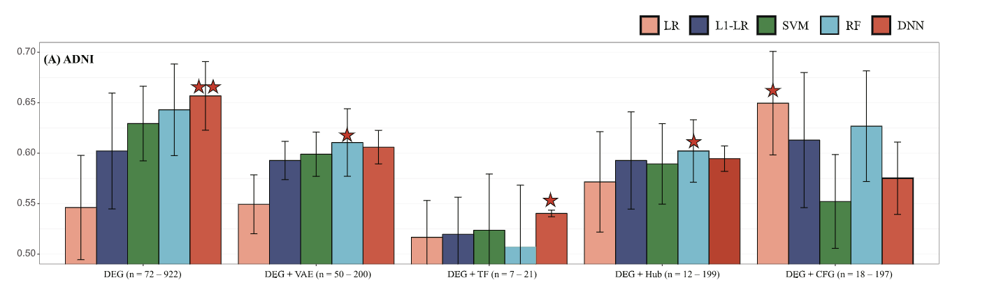
Proposed Method:
Data Preprocessing
Ignoring gene expression less than the median value which where (3.897, 7.584, 6.154) for the three datasets and after than select only the probes common in all three data set.
Normalize each dataset.
Feature extraction
Use VAE to represent the input as input dimension is huge.
Extract the TF related genes [7]
Classification
Employ LR, L1-LR, SVM, RF, DNN
Result / Validation
Internal and External Validation

Slide 9
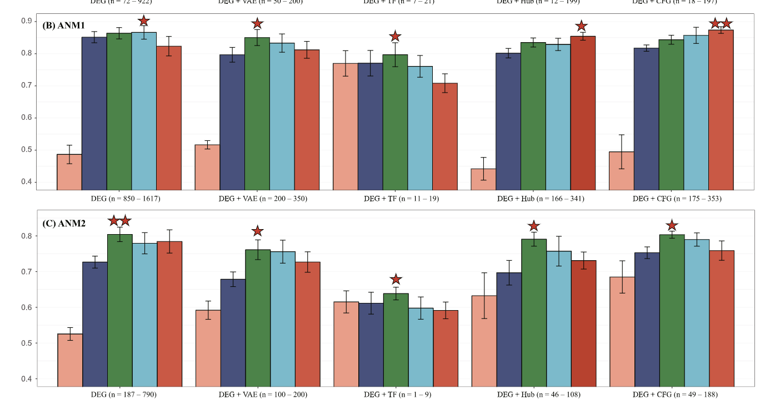

Slide 10
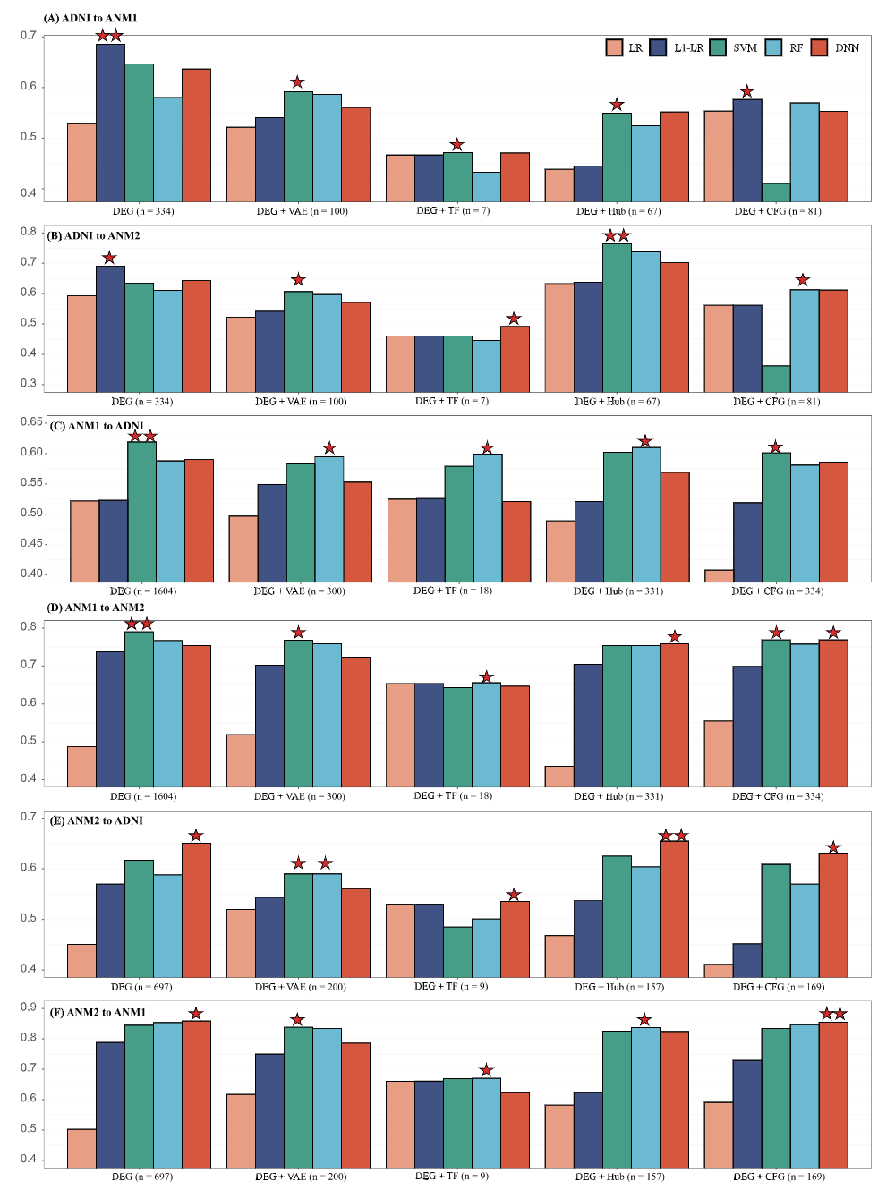

Slide 11
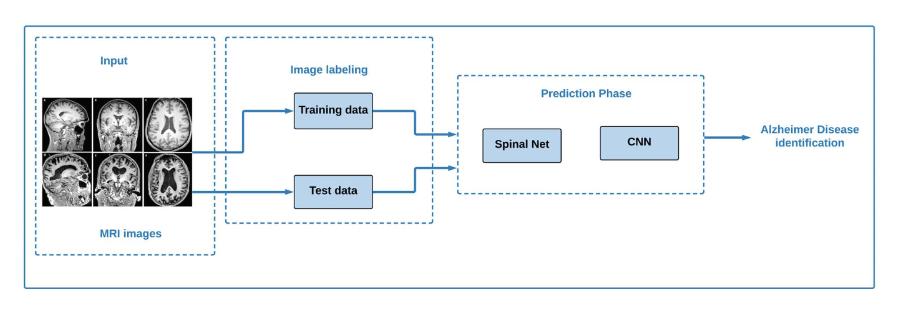
In this study first, SpinalNet and convolutional neural network (CNN) is used to classify AD from MRI images. Then microarray gene expression data to classify the diseases k-nearest neighbours (KNN), support vector classifier (SVC),and Xboost classifiers. Most the algorithms approaches use only either image or gene expression, while in this they have used both the data together and explained the results using trustworthy methods by using explainable artificial intelligence (XAI).
Alzheimer’s Patient Analysis Using Image and Gene Expression Data and Explainable-AI to Present Associated Genes, Md. Sarwar Kamal , Aden Northcote , Linkon Chowdhury, Nilanjan Dey , Rubén González Crespo and Enrique Herrera Viedma - 2021
Fig : Proposed method to classify using MRI

Slide 12
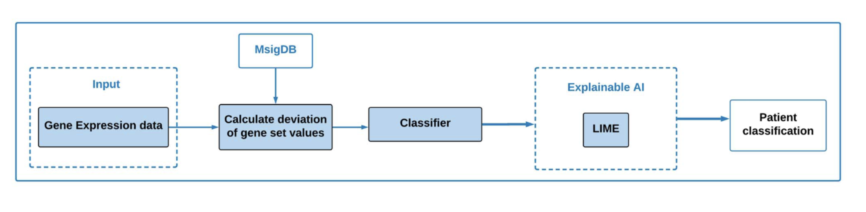
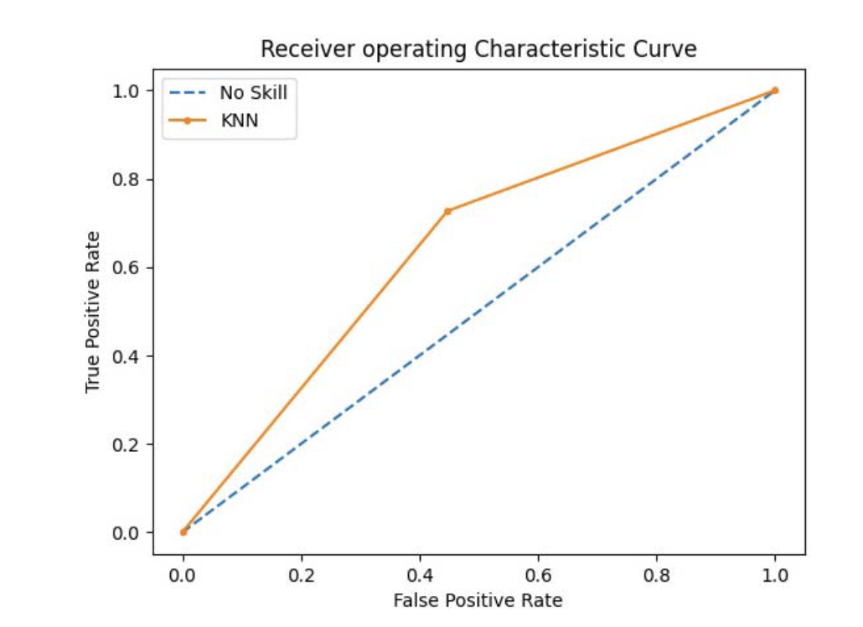
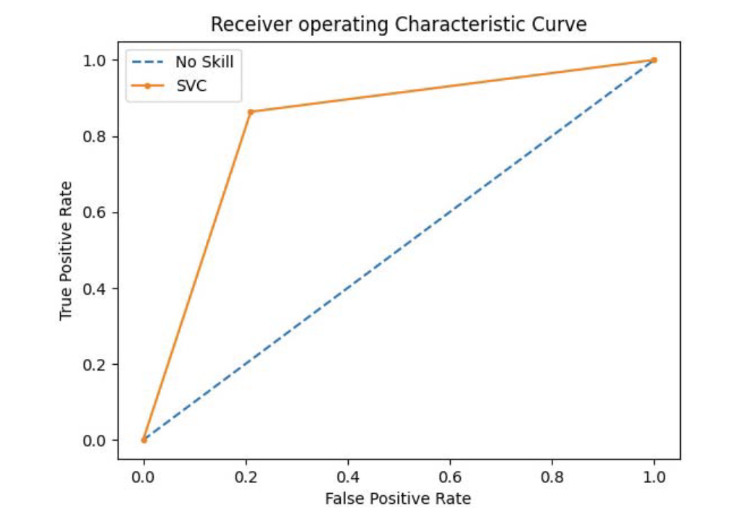
Fig : Proposed method to classify using gene expression
Fig : ROC curve of KNN
Fig : ROC curve of SVC

Slide 13
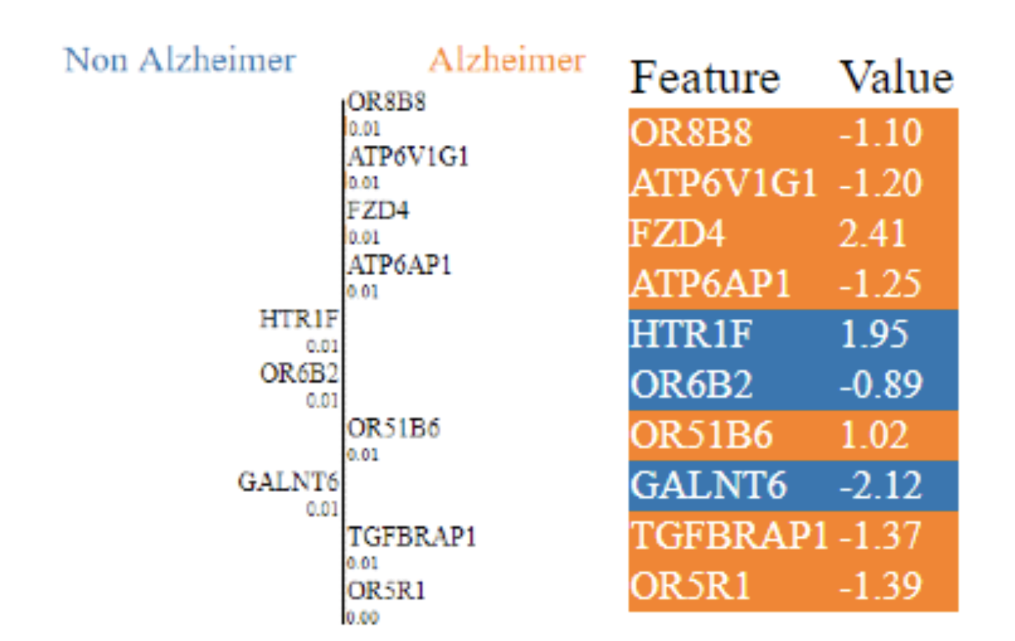
Outcome of XAI
LIME mechanism was used to make the output of the classifier more interpretable.
Genes like OR8B8 and ATP6V1G1 were found to the highly significant genes for AD

Slide 14
This study was to provide early diagnosis of AD using embedded feature selection process. An AD DNA methylation [8] data set having 34 AD samples and 34 heath control samples were used from GEO omni bus repository. Four embedded feature selection models were used along with Enhanced Deep Recurrent Neural Network (EDRNN), DRNN, CNN, RNN. Dataset: GSE76105 from GEO Omnibus repository is used. Proposed Method: 1. Pre-processing : eliminate poor samples based on the p-value. 2. Normalize the data. 3. Embedded Feature Selection : LASSO (Least Absolute shrinkage and selection operator), SVM, AdaBoost, Random Forest. 4. Classification : RNN, CNN, DRNN, EDRNN Results: The accuracy was the highest (at 87%) when AdaBoost model used along with EDRNN for classification.
A deep learning framework with an embedded-based feature selection approach for the early detection of the Alzheimer’s disease, Nivedhitha Mahendran, Durai Raj Vincent P M - 2022

Slide 15
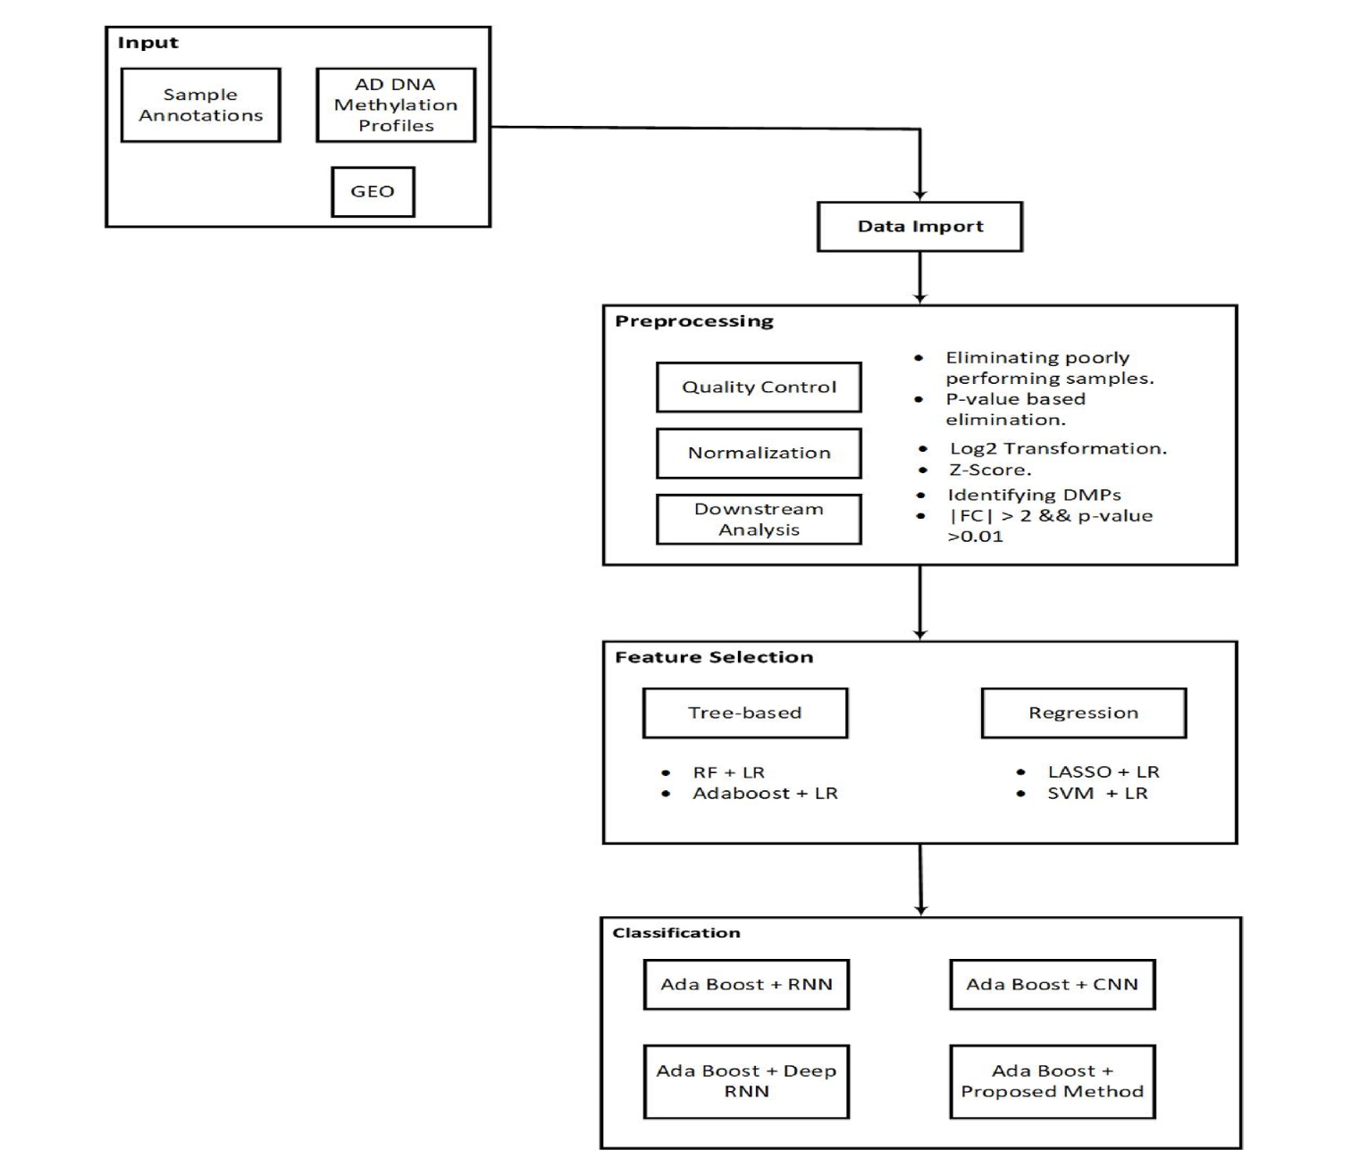
Fig : proposed method

Slide 16
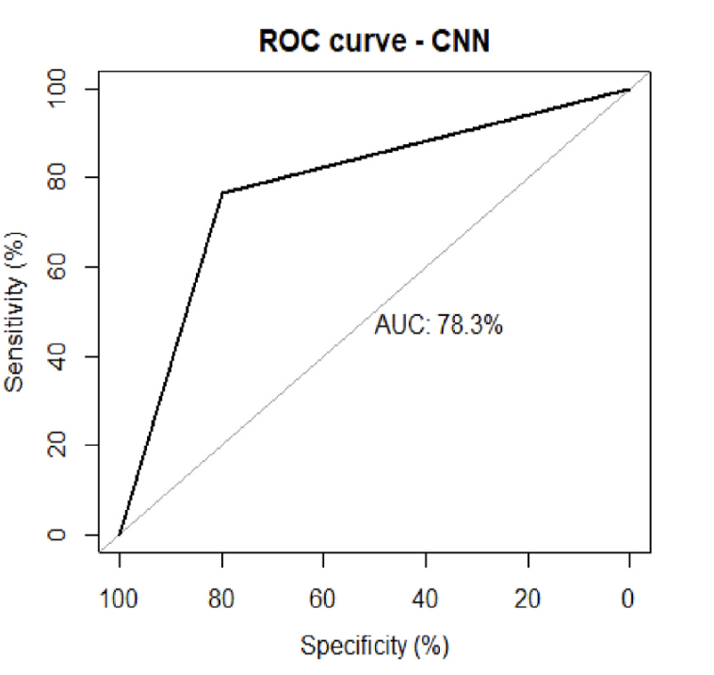
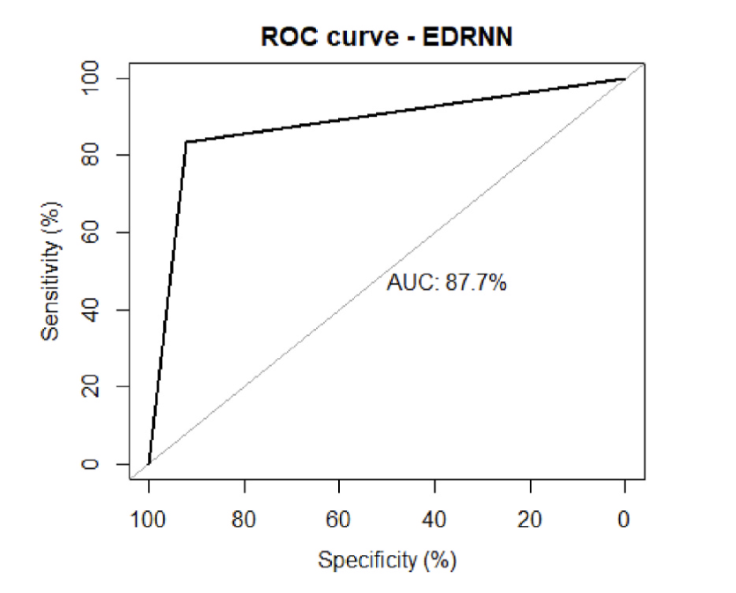
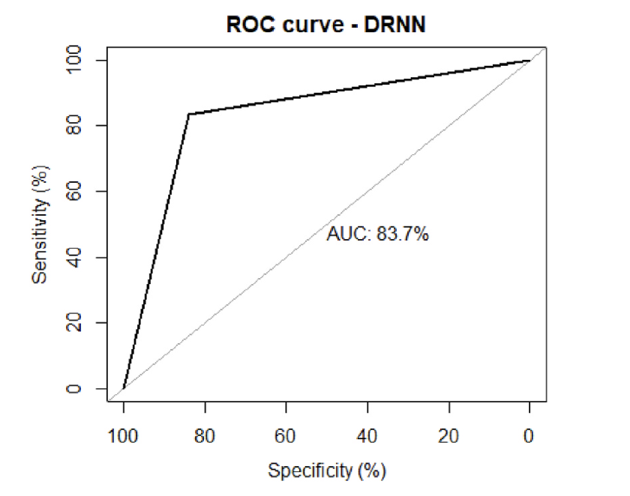
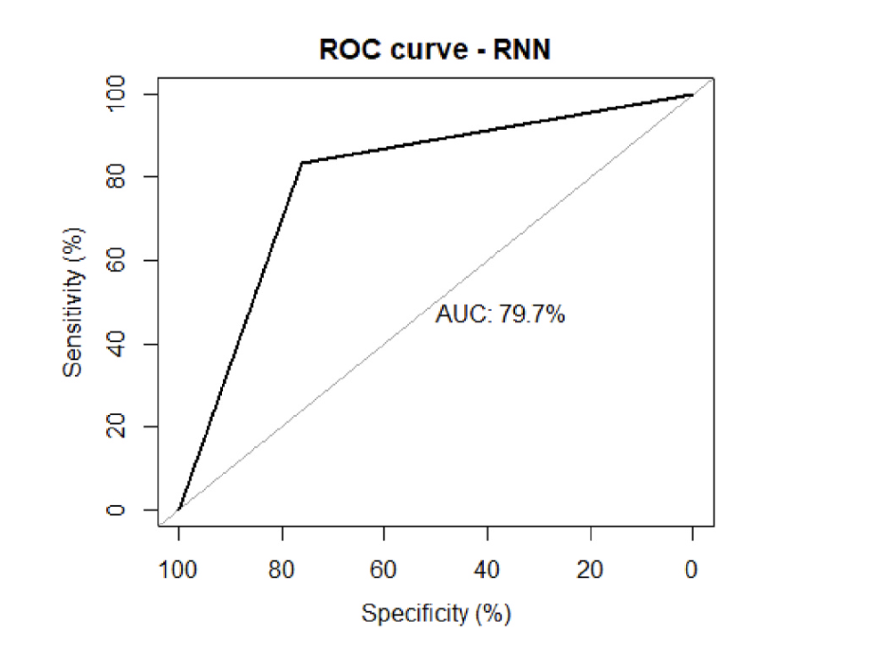

Slide 17
In this study separately the potential of the peripheral blood gene expression data as well as the Single Nucleotide Polymorphism (SNP) data in building ML models for AD classification is analysed. A systematic approach on feature selection and ML model design using both types of genetic data provided by the Alzheimer’s Disease Neuroimaging Initiatives (ADNI). Two-step feature selection produced a curated list of important genes. In addition to these selected genetic features, to examine the role of non-genetic covariates, Age and number of education years (EDU) as extra features are included.
Alzheimer’s Disease Classification Using Genetic Data, Subash Khanal, Jin Chen Nathan Jacobs, Ai-Ling Lin- 2021
Feature | Included additional Feature | AUC
Gene Expression | No | 0.64
 | Yes | 0.65
SNP | No | 0.56
 | Yes | 0.64

Slide 18
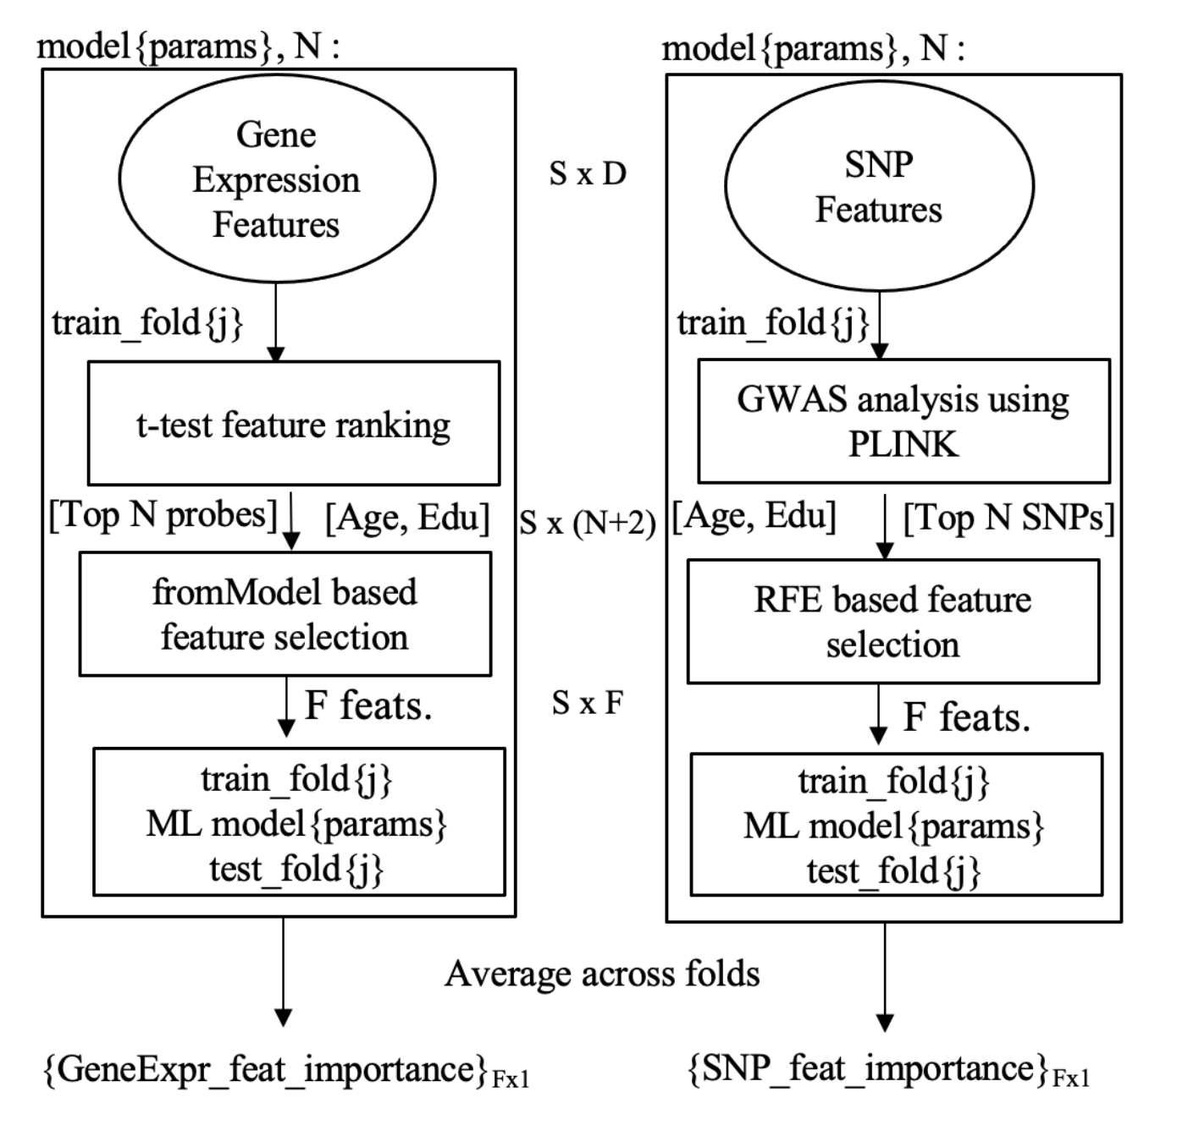
Model Training on Gene Expression
t-test carried out between the groups of genes
Feature selection from the N genes selected from the above step (Recursive feature elimination used (RFE))
Added additional features to improve model performance XGBoost classifier
Model Training on SNP data
Similar step as for gene expression used.
Feature selection algorithms like LR is performed using tool PLINK [9]
Added additional features to improve the performance of Model.

Slide 19
This study is intended to introduce a symmetric framework to predict AD from Gene Expression (GE) data, with the aim to produce the most accurate prediction using the smallest number of genes. The framework works in four stages after it receives a training dataset: pre-processing, gene selection (GS), classification, and AD prediction. The symmetry of the model is manifested in all of its stages. In the pre-processing stage gene columns in the training dataset are pre-processed identically. In the GS stage, the same user-defined filter metrics are invoked on every gene individually, and so are the same user-defined wrapper metrics. In the classification stage, a number of user-defined ML models are applied identically using the minimal set of genes selected in the preceding stage. The core of the proposed framework is a meticulous GS algorithm which we have designed to nominate eight subsets of the original set of genes provided in the training dataset.
Machine Learning Framework for the Prediction of Alzheimer’s Disease Using Gene Expression Data Based on Efficient Gene Selection, Aliaa El Gawady , Mohamed A. Makhlouf , BenBella S. Tawfik and Hamed Nassar - 2022
Sensitivity | Specificity | precision | Kappa index | AUC | accuracy
0.97 | 0.97 | 0.98 | 0.945 | 0.972 | 0.975

Slide 20
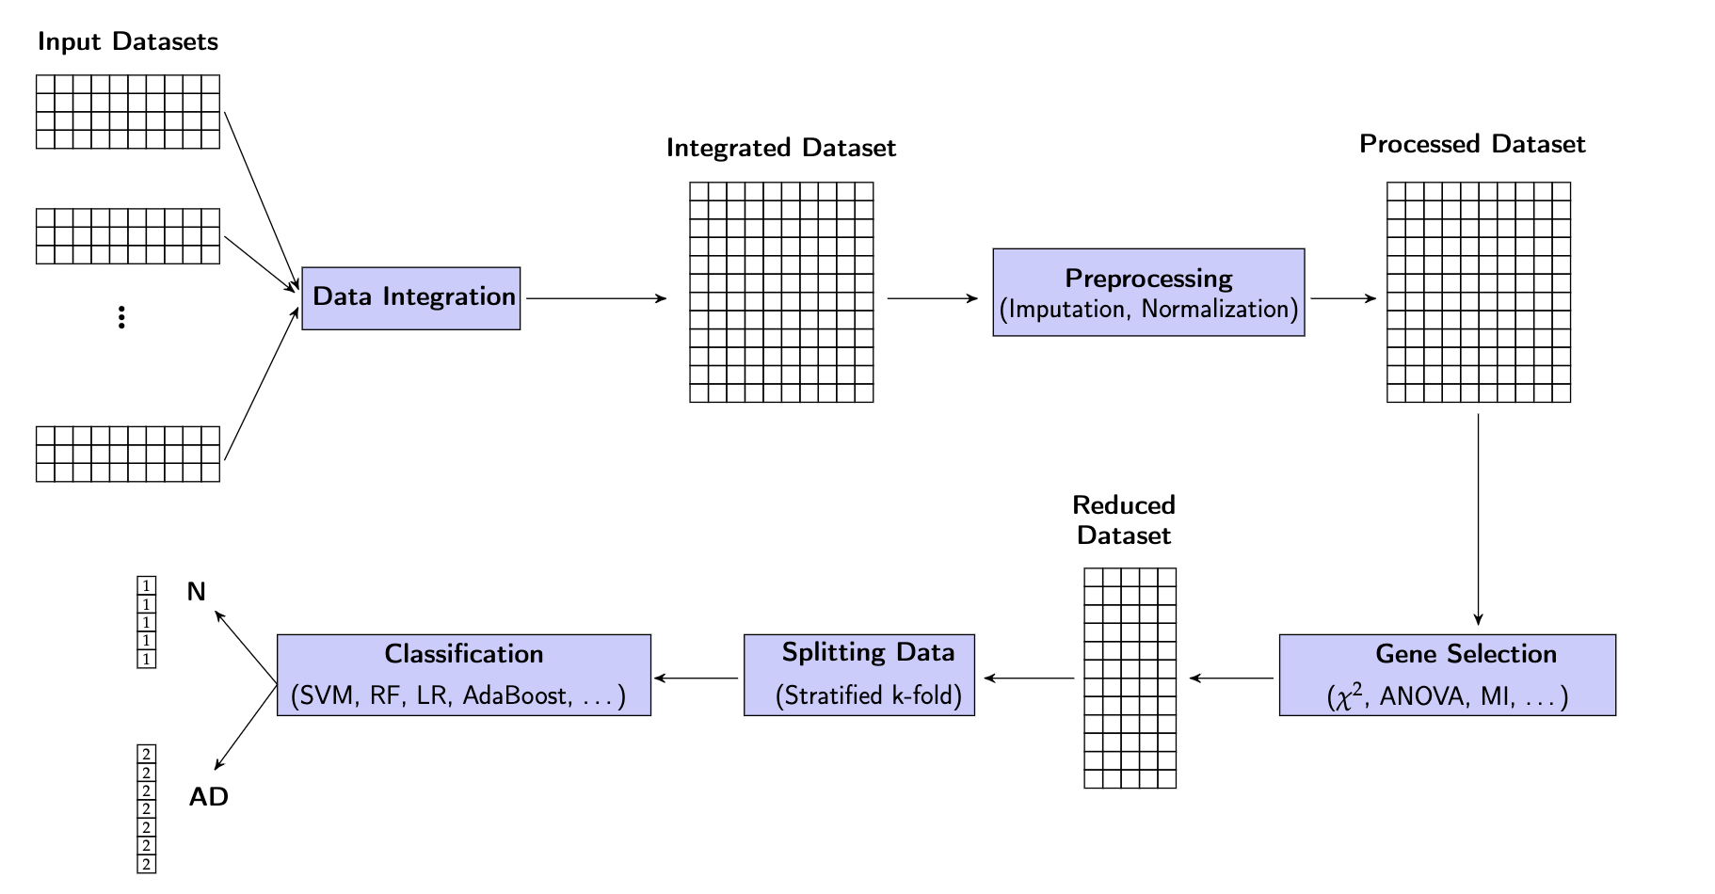

Slide 21
Chi squared
χ2 is a well-known statistical metric used to examine the dependence between two random variables, in this situation a gene and the target output, which is the case diagnosis, AD or N.
Analysis of variance
Analysis of variance (ANOVA) is a powerful family of techniques to test the significance of the difference between the means of two random variables. In this situation, the two variables are a gene and the target output, which is the case diagnosis, AD or N
Mutual information
mutual information I(X, Y) which measures the shared information between two random variables X and Y. In our situation, the two variables are a gene and the target output, which is the diagnosis, AD or N.

Slide 22
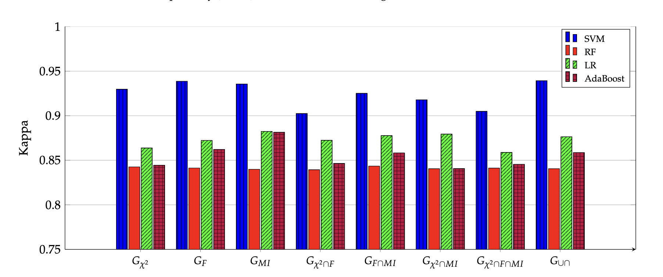
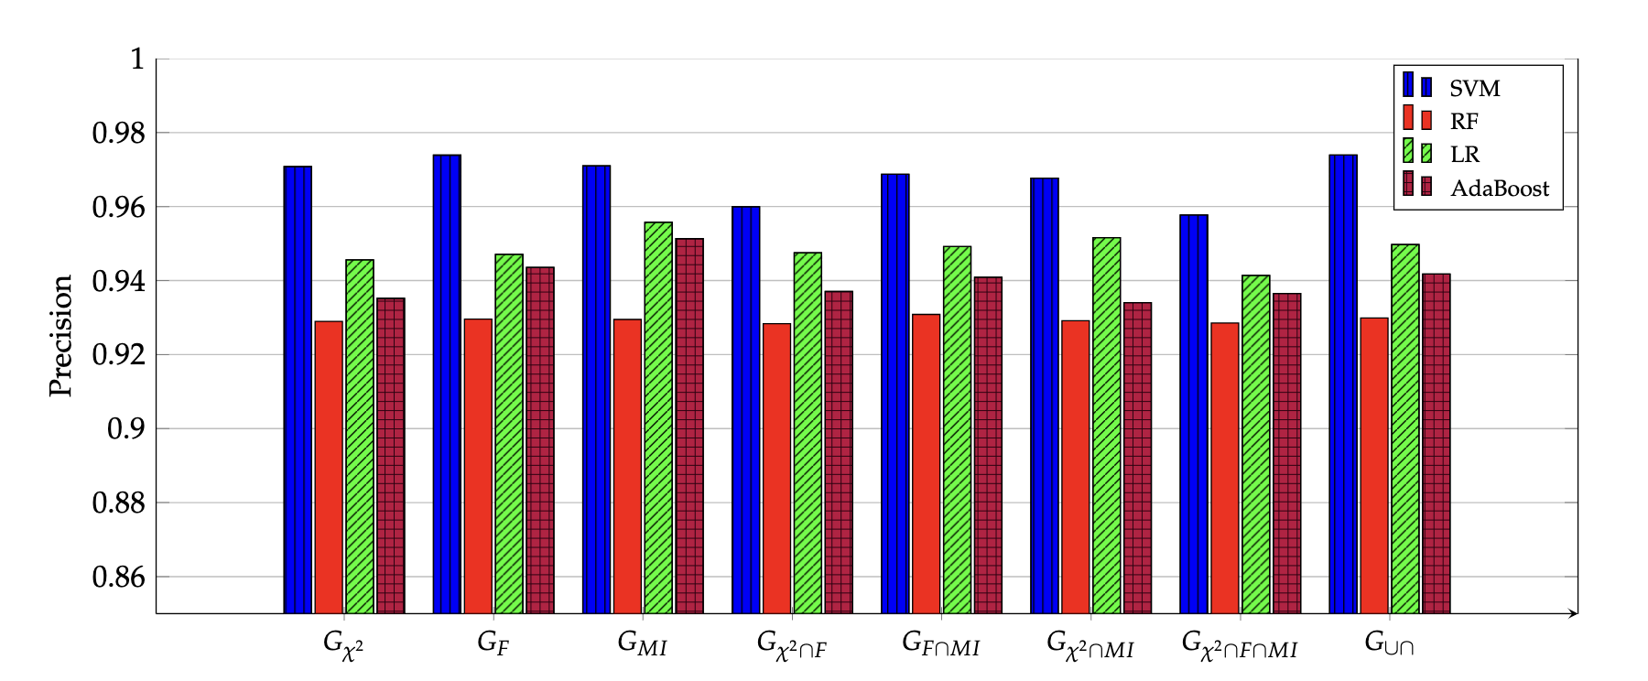
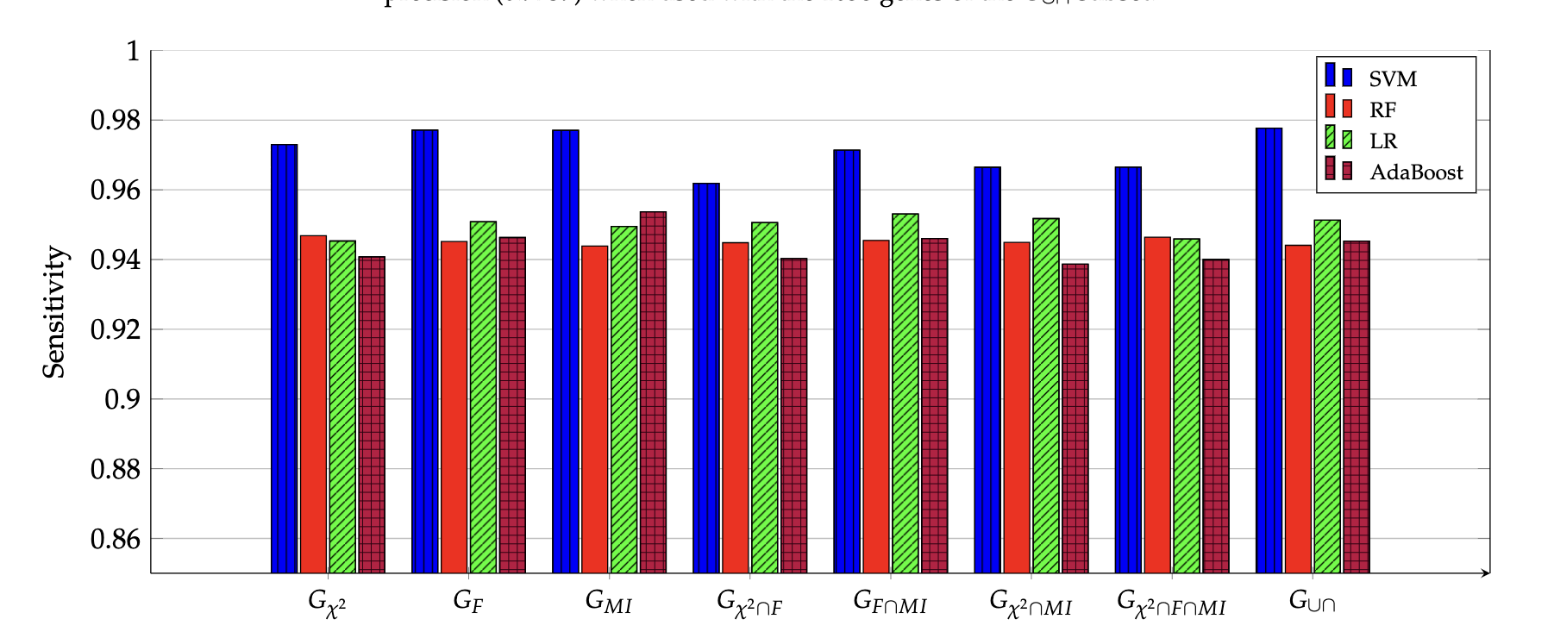
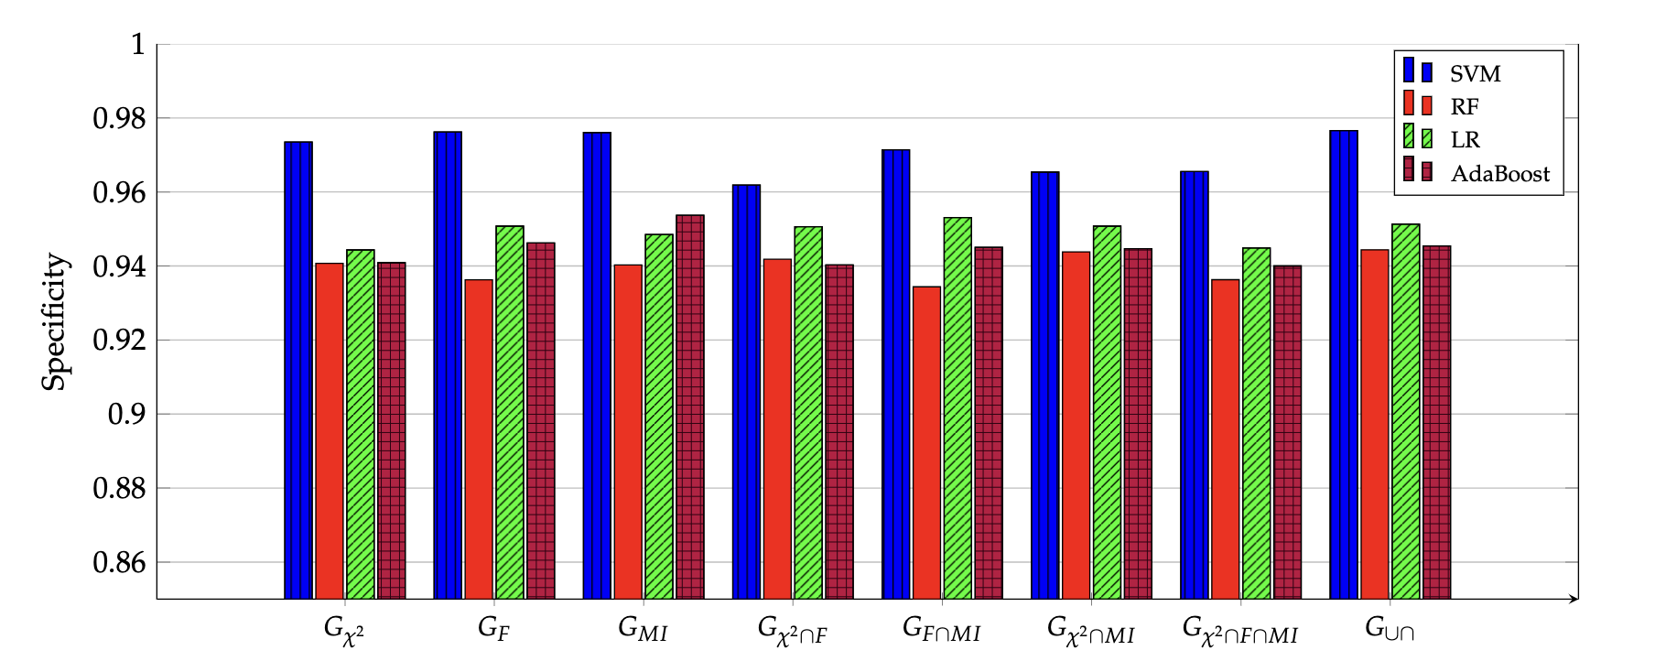

Slide 23
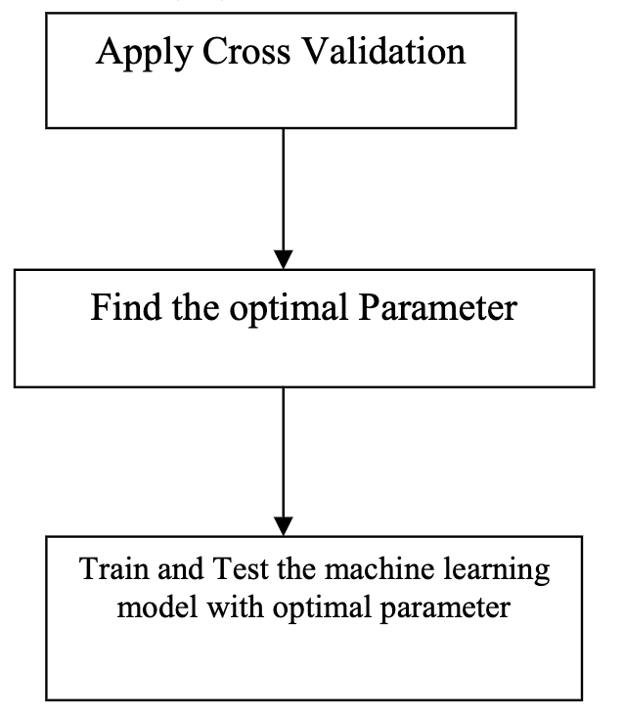
This study explores the classification algorithms including logistic regression, support vector classifier, decision tree, and random forest classifier. The models are fine tuned by choosing optimal values for parameters that influences the accuracy of the model. The optimal parameters are found using a K-fold cross validation score, and the models are generated using that. The dataset used in the model is longitudinal cross-sectional data from OASIS. It has been inferred from the results that random forest classifier performs well than the other models.
Detection of Alzheimer’s disease at Early Stage using Machine Learning, S.Pavalarajan, B.Arun Jumar, S.Shahul Hammed, K.Haripriya, C.Preethi, T.Mohanraj - 2022

Slide 24
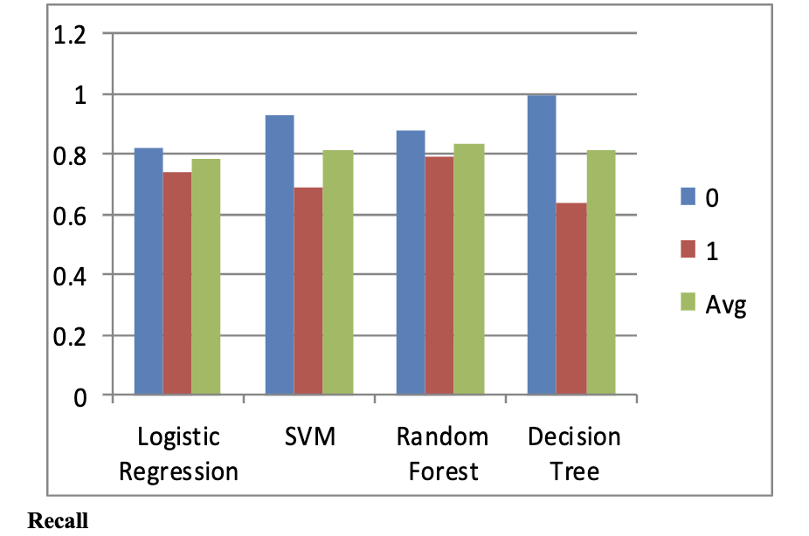
Data Pre-Processing
Handling missing data
Feature scaling
Train test split
Machine Learning Model
Logistic Regression
Support Vector Machine
Decision tree
Random Forest

Slide 25
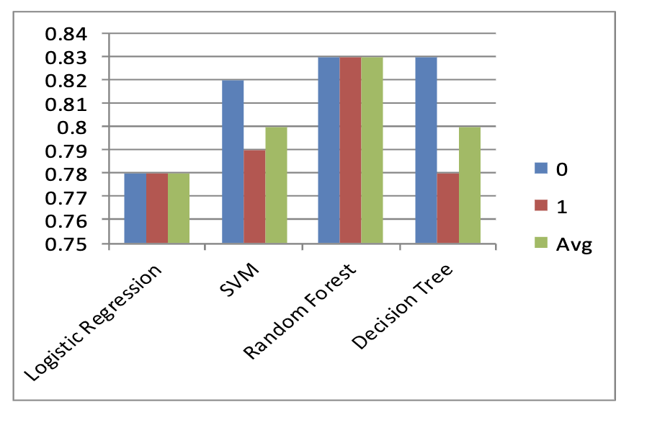
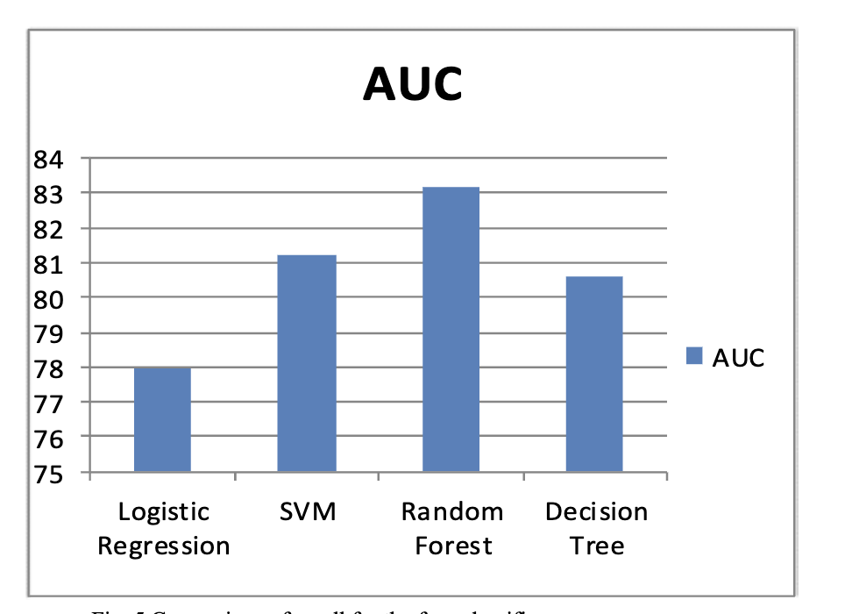
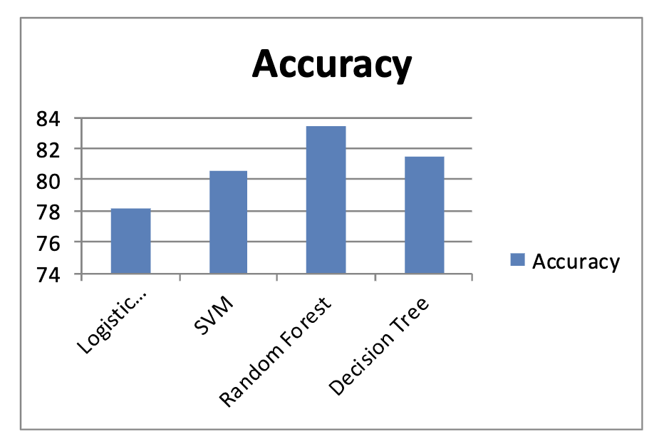

Slide 26
This study is done to reduce laborious, and time-consuming task of classifying AD groups, different deep learning algorithms were investigated to automate the AD detection and prediction. In this study, the potency of transfer learning approach was analysed in detail by fine tuning the deeper layers of Transfer Learning models like VGG-19, VGG-16, Resnet-50 and Xception. In prior work, VGG-16 model was experimented on the ADNI datasets to get an accuracy of 97% and a precision of 96%. From this study, it is analysed that the overall classification accuracy and precision of VGG- 19 is exceptionally high (98%) when compared to other models. This shows that the automated method can be a true guide in Alzheimer’s detection and prediction, especially when an early-stage diagnosis may help to get the benefit of treatment.
A Transfer Learning Approach for Predicting Alzheimer’s Disease, Sreeja Shashidhar Rajeswari, Manjusha Nair - 2021

Slide 27
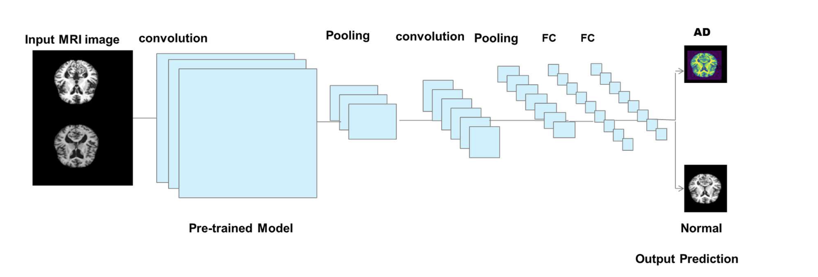
Transfer Leering Model
A pre-trained model is reused by freezing the dense layers or the final layer to train a complex or a large model.
Models such as VGG-19, VGG-16, ResNet-50 and Xception are explored and Xception found to the one with better accuracy.

Slide 28
References
[1] Global and regional projections of the economic burden of Alzheimer's disease and related dementias from 2019 to 2050, The Lancet, 22 July 2022.
[2] Anil Kumar, Arti Singh, et al. A review on Alzheimer's disease pathophysiology and its management: an update. Pharmacological reports, 67(2):195–203, 2015.
[3] C. Patterson, “World Alzheimer report 2018 the state of the art of dementia research: New frontiers,” Alzheimer’s Disease Int. (ADI), London, U.K., Tech. Rep., 2018. [Online]. Available: https://www.alzint.org/u/WorldAlzheimerReport2018.pdf
[4] Jungsu Kim, Jacob M Basak, and David M Holtzman. The role of apolipoprotein e in Alzheimer's disease. Neuron, 63(3):287–303, 2009.
[5] Laura Spinney. Alzheimer’s disease: The forgetting gene. Nature News, 510(7503):26, 2014.
[6] M Tanveer, B Richhariya, RU Khan, AH Rashid, P Khanna, M Prasad, and CT Lin. Machine learning techniques for the diagnosis of alzheimer’s disease: A review. ACM Transactions on Multimedia Computing, Communications, and Applications (TOMM), 16(1s):1–35, 2020.
[7] Matys, V. et al. TRANSFAC® and its module TRANSCompel®: transcriptional gene regulation in eukaryotes. Nucleic Acids Res. 34, D108–D110 (2006)
[8] The role of DNA methylation in epigenetics of aging, Archana Unnikrishnan, Willard M. Freeman, Jordan Jackson, Arlan Richardson, March 2019
[9] Shaun Purcell, Benjamin Neale, Kathe Todd-Brown, Lori Thomas, Manuel AR Ferreira, David Bender, Julian Maller, Pamela Sklar, Paul IW De Bakker, Mark J Daly, et al. Plink: a tool set for whole-genome association and population-based linkage analyses. The American journal of human genetics, 81(3):559–575, 2007

